Slide 1
Learning Basics of Embedded Systems

Slide 2
1970’s- Memory Model of old computers

Slide 3
Memory Model – How 1bit info is stored

Slide 4
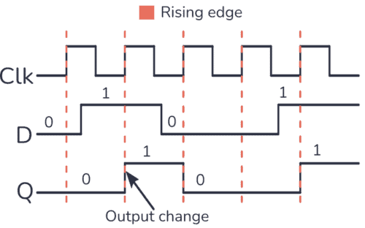








Read and write in D-flipflop

Slide 5









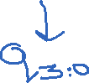












4 bit Register

Slide 6






DeMux – 8bit FlipFlop - Mux

Slide 7









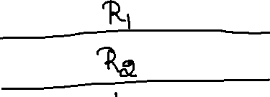












8Bit Register Memory

Slide 8
CPU Model

Slide 9











Von Neuman Architecture

Slide 10







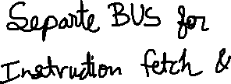





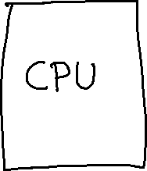
Harvard Architecture

Slide 11
Instruction Fetch Stage

Slide 12

















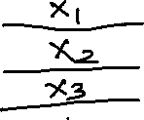



Instruction Processing

Slide 13
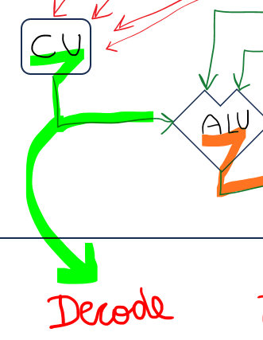







Decode

Slide 14
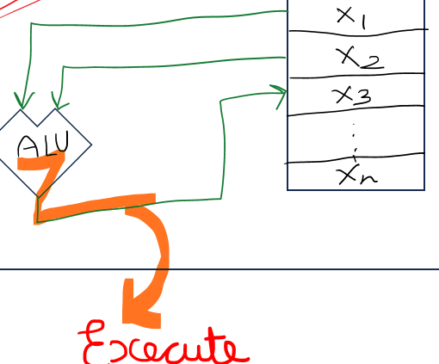






Execute

Slide 15
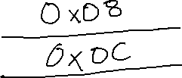





Program Counter

Slide 16
1,2,3

Slide 17





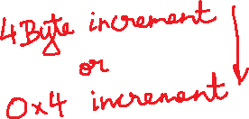






















RV32I

Slide 18






















What are the instruction?

Slide 19




















Slide 20
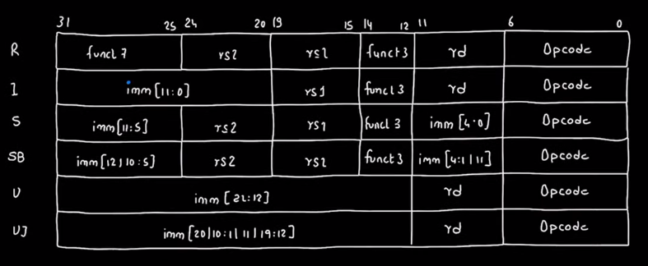
Types of instruction

Slide 21
RISC-V card

Slide 22
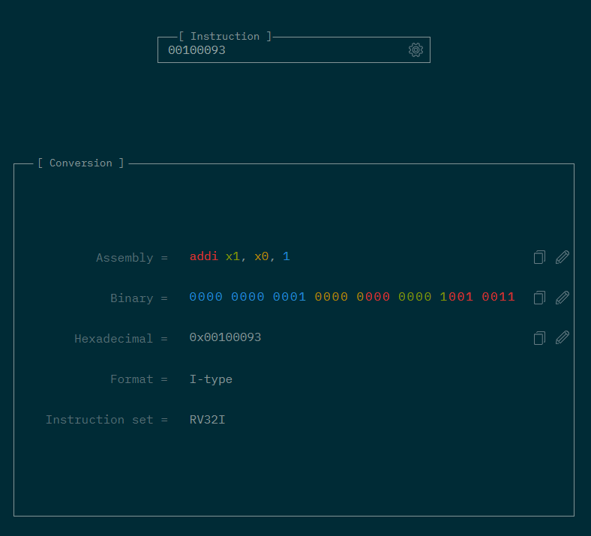








Overview
https://luplab.gitlab.io/rvcodecjs/

Slide 23



















Make file
all: main.s foo.c
$(GCC) -O0 -ggdb -nostdlib -march=rv32i -mabi=ilp32 -Wl,-Tmain.ld main.s -o main.elf
$(OBJCOPY) -O binary main.elf main.bin
xxd -e -c 4 -g 4 main.bin

Slide 24









Make file
all: main.s foo.c
$(OBJCOPY) -O binary main.elf main.bin
xxd -e -c 4 -g 4 main.bin

Slide 25
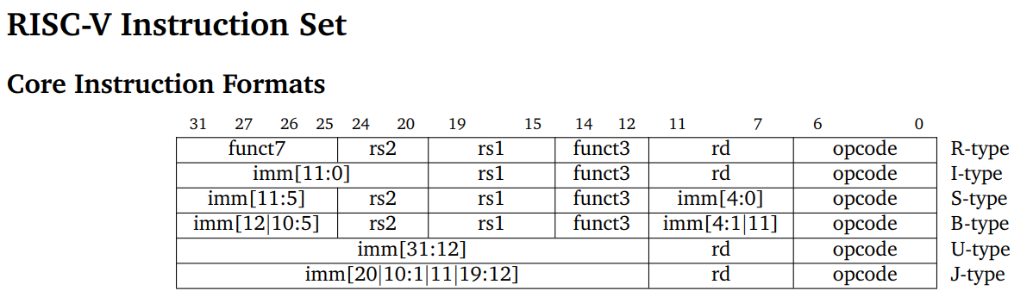
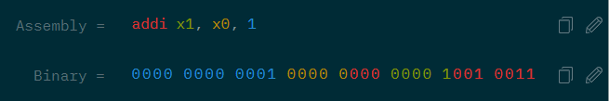
000000000001 00000 000 00001 0010011

Slide 26
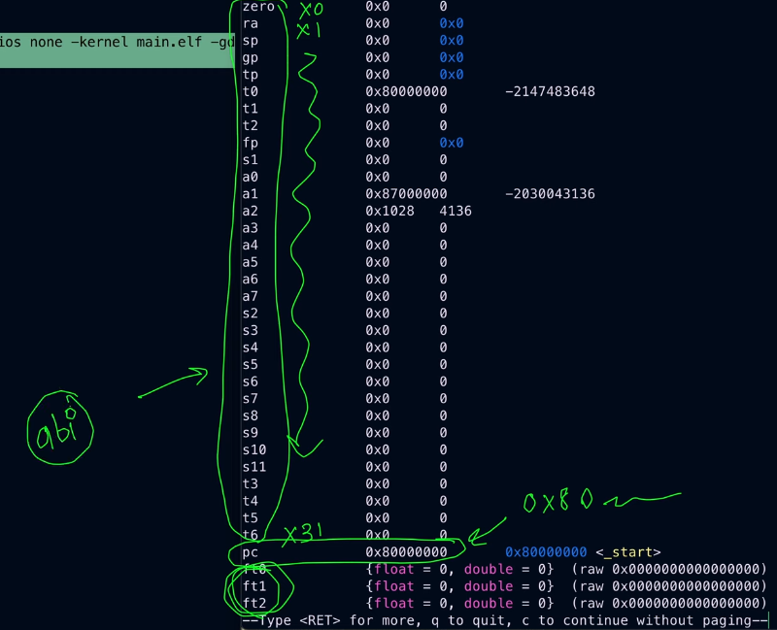















Slide 27
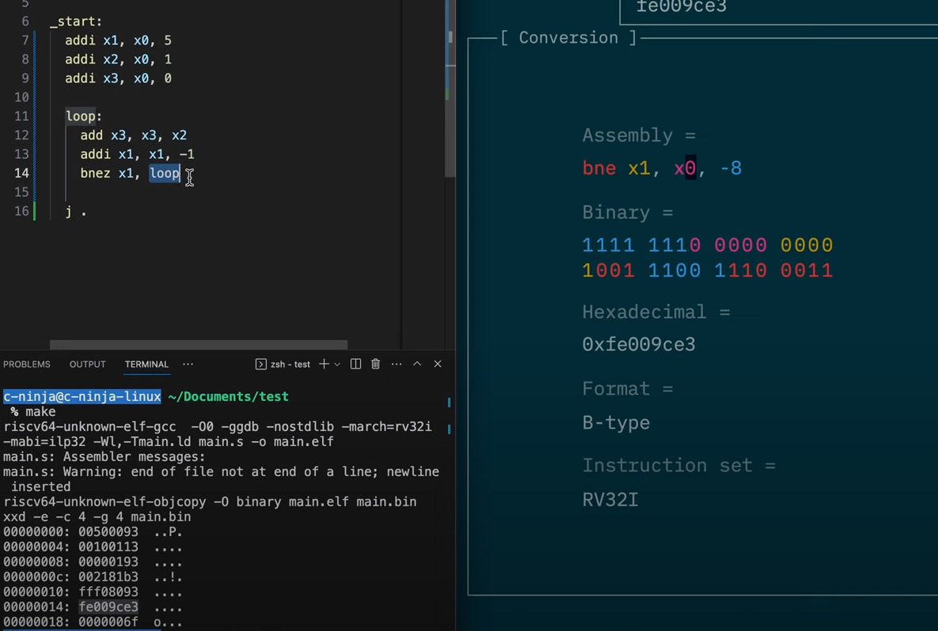

Slide 28
Very Useful lab session
https://youtu.be/pJnzFf-IOvI?si=o1Ivu4PK3AQ_QL3w
https://eseo-tech.github.io/emulsiV/

Slide 29
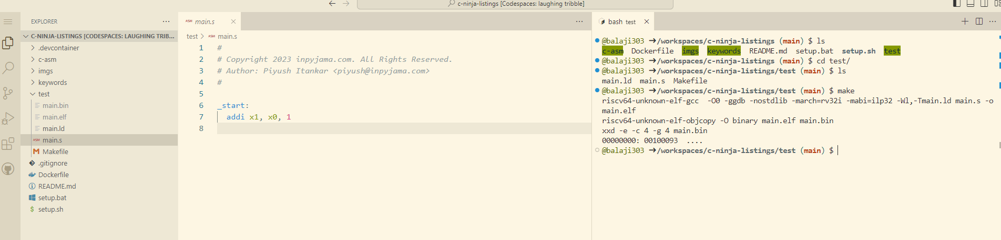

Hex file content

Slide 30
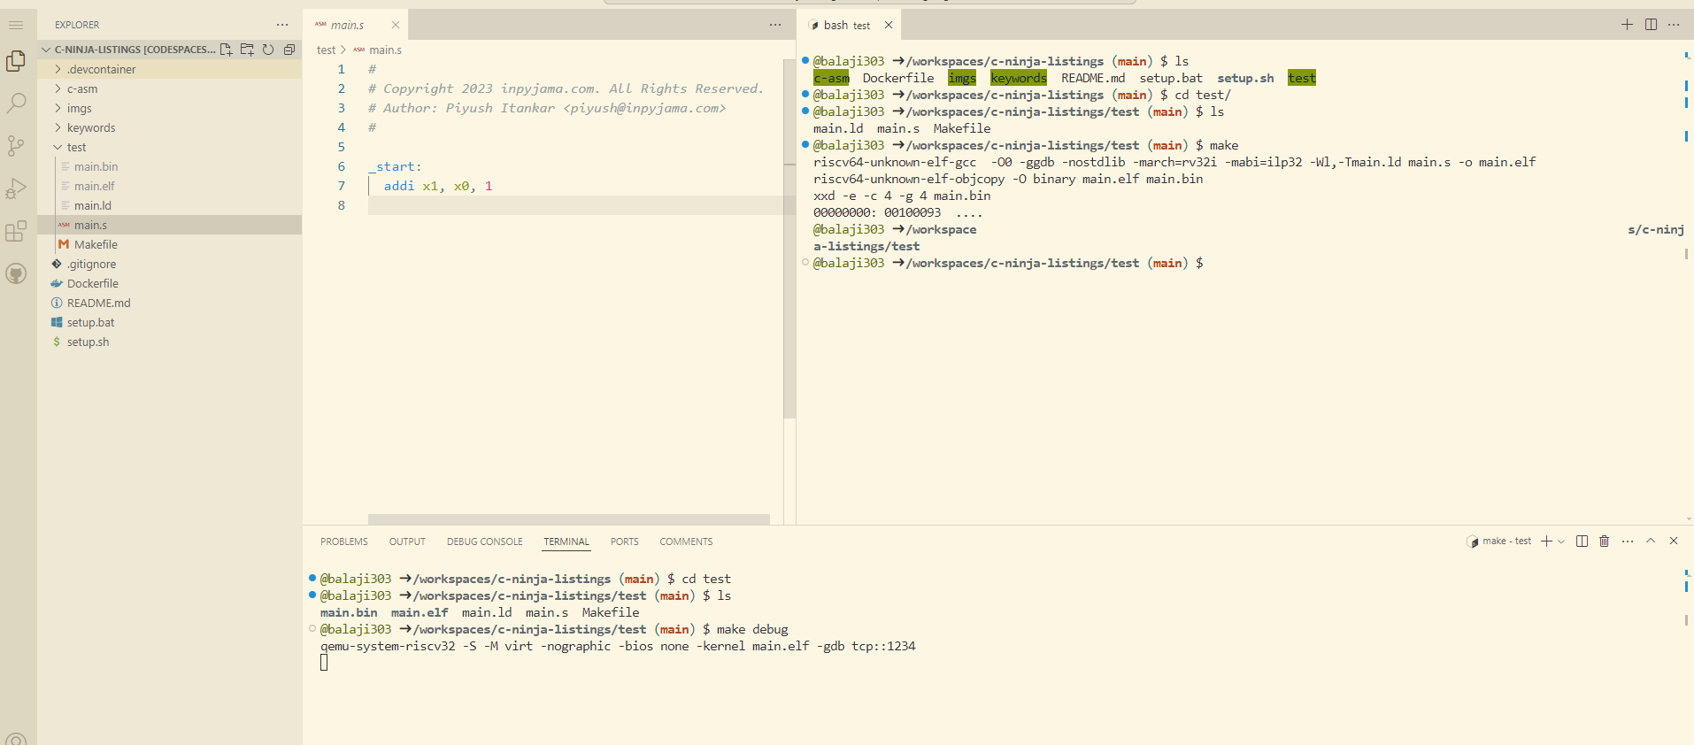
Make gdb HERE to see breakpoint view
This creates a port for GBD

Slide 31
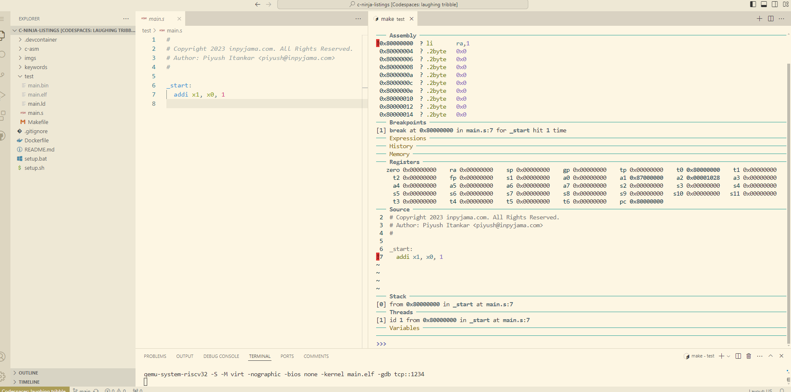
These are API name, so ra, sp
These are non-API name, so x1,x0

Slide 32
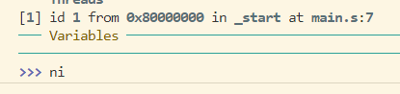
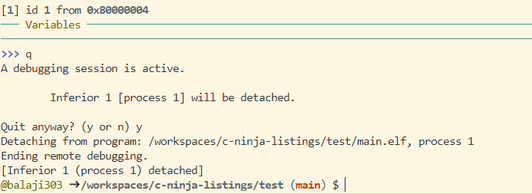
Ni -> Next instruction
q-> quit

Slide 33
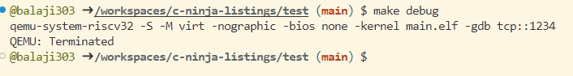
Ctrl+A and X -> QEMU exits

Slide 34
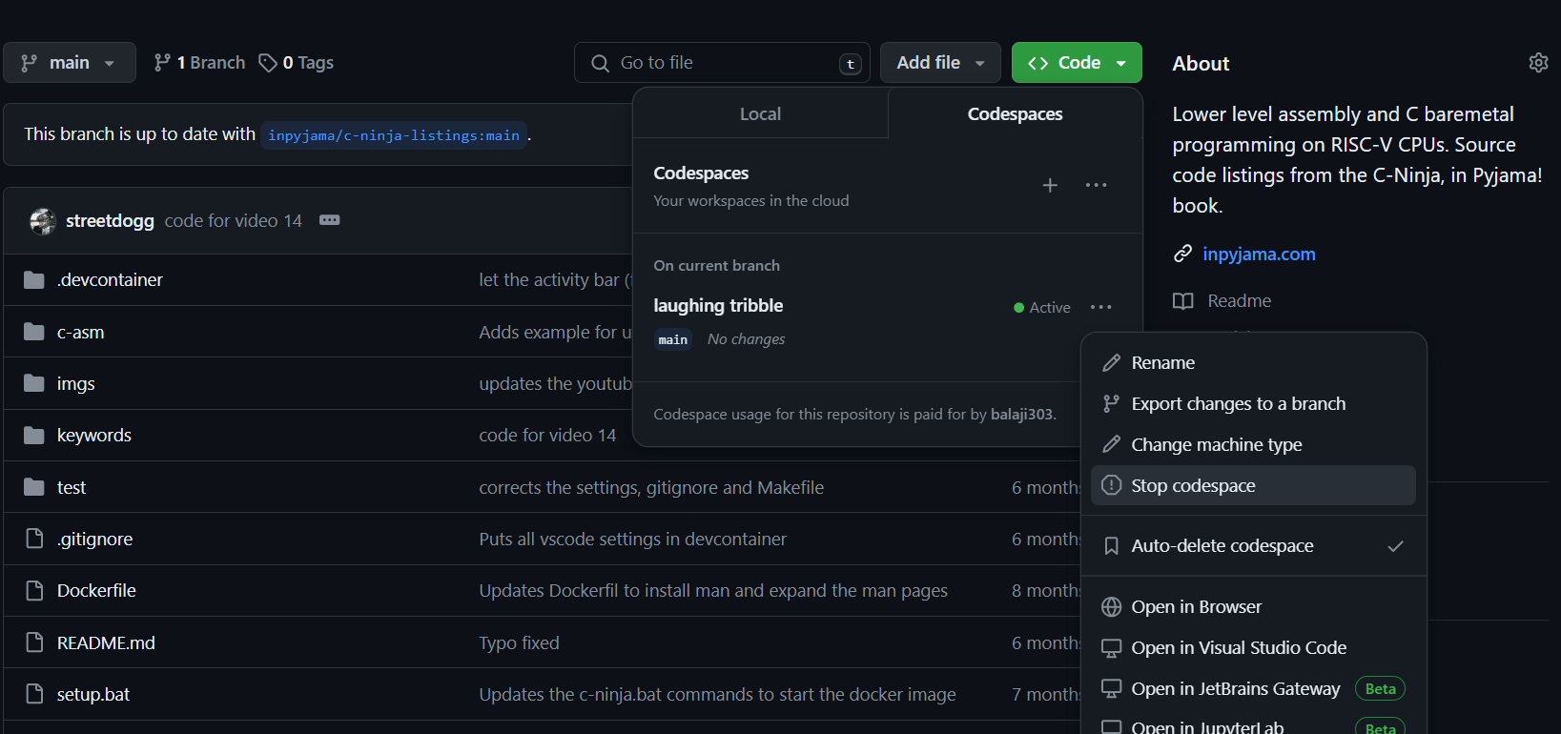
Stop your CodeSpace

Slide 35
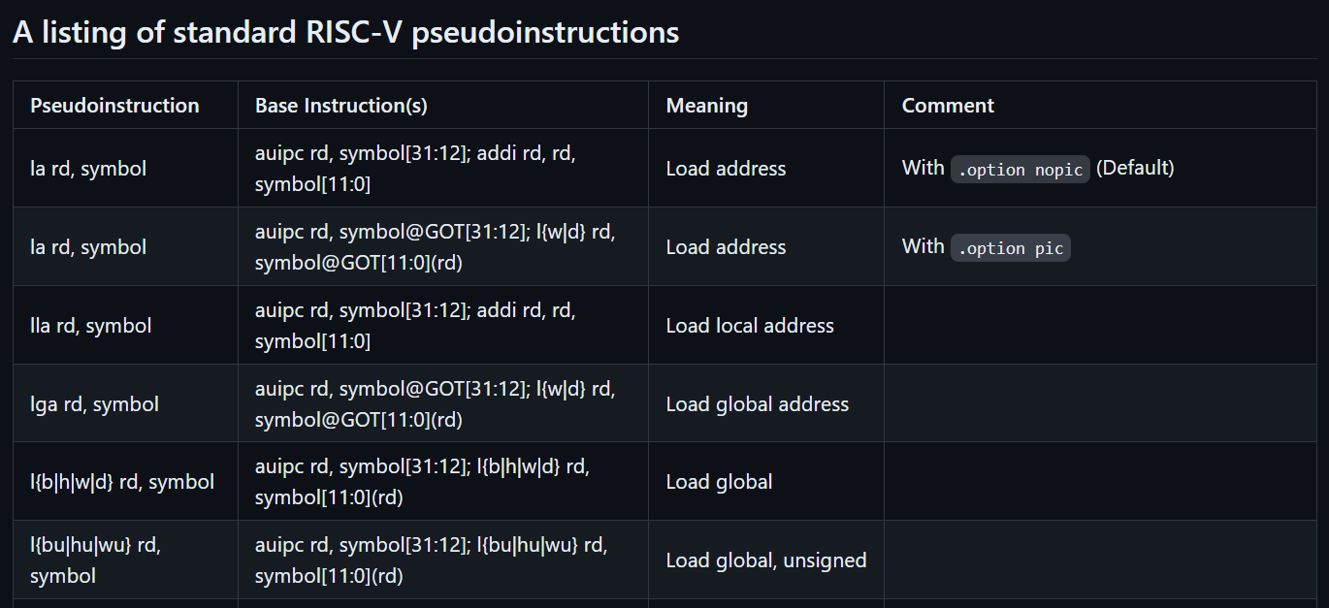
Pseudo Instructions
PSEUDO instructions are assembly language in short form
https://github.com/riscv-non-isa/riscv-asm-manual/blob/master/riscv-asm.md

Slide 36
Asm: j bar C: void foo(){return;} void bar(){return;} In Makefile: make ccode.s file as separate make command make ccode.s file along with make_all

Slide 37
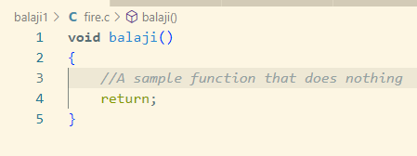
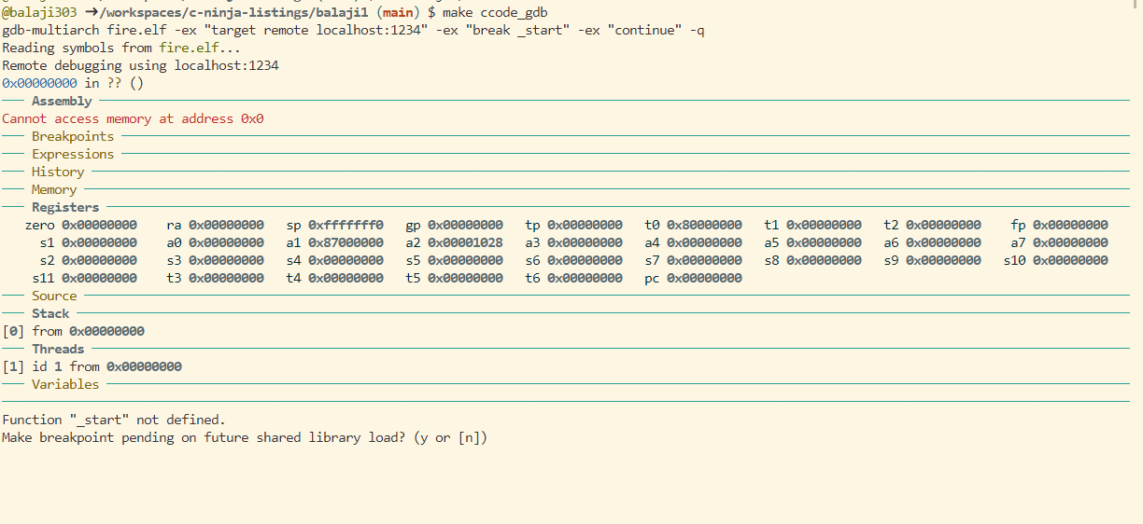
Steps in balaji1 folder
Create a new repo -> balaji1
Create a new C file -> fire.c
Use the same map and make file in test repo
Since there is _start we get error

Slide 38
SP -> Stack Pointer
Add this at the top like MACRO definition
OBJDUMP = $(TOOL_CHAIN_PREFIX)objdump
Add this to make all below OBJCOPY
$(OBJDUMP) –D –S main.elf > mail.elf.lstd

Slide 39
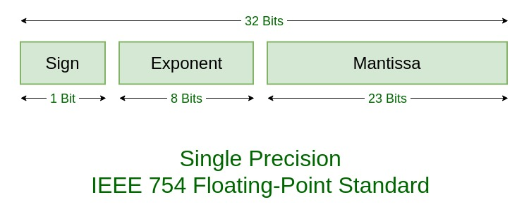
Floating point storage mechanisms
IEEE Standard 754 is used
https://www.geeksforgeeks.org/ieee-standard-754-floating-point-numbers/

Slide 40
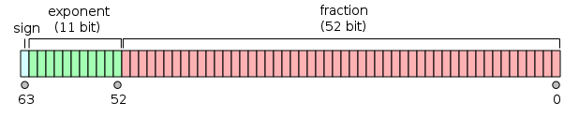
Double precision floating point storage
IEEE 754 double-precision binary floating-point format
https://en.wikipedia.org/wiki/Double-precision_floating-point_format

Slide 41
Todo
Short int a = 10;
Int short a = 10;
Long int b = 20;
Int long b = 20;
Long l = 2;
Long long int c = 30;
Long long ll = 33;
Float f = 2.2;
Double dd = 0.5

Slide 42
store
Sb -> store byte
Sw -> store word
Sh -> store half word

Slide 43
https://www.tutorialspoint.com/two-s-complement#:~:text=To%20get%202's%20complement%20of,01101)%20%2B%201%20%3D%2001110.

Slide 44
how -2 is stored in binary
Determine the bit length: For the range -128 to 127, we use 8 bits.
Convert the positive equivalent: Find the binary representation of the positive equivalent of the number. For -2, the positive equivalent is 2.
The binary representation of 2 is 0000 0010.
Invert the bits: Change all 0s to 1s and all 1s to 0s (this gives the one's complement).
Inverting 0000 0010 gives 1111 1101.
Add 1 to the one's complement: This step converts the one's complement to the two's complement, which represents the negative number.
Adding 1 to 1111 1101 gives 1111 1110.

Slide 45
Default
By default the variables are unsigned, we need to specify signed to make them have –ve variables

